Slide 1
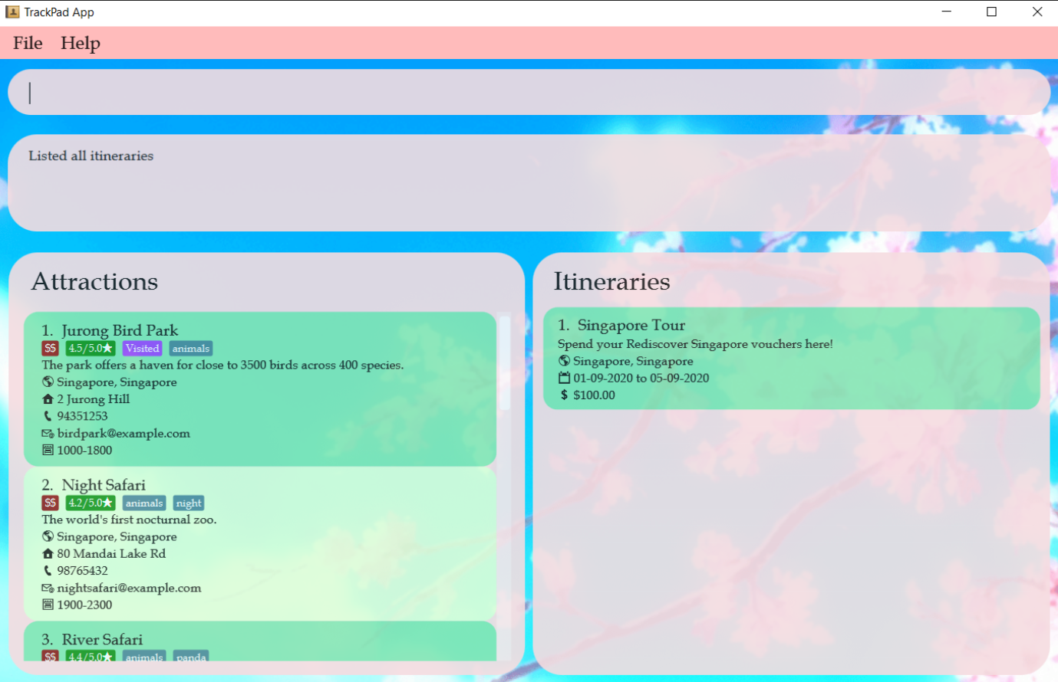
Command Box
Result Box
Attractions Panel
Itinerary Panel

Slide 2
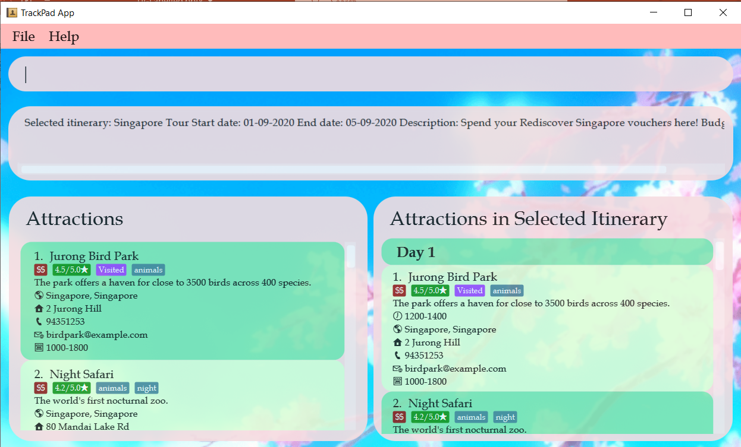
Selected
Itinerary
Attraction in
Selected Itinerary

